Slide 1


Fundamentals of Project Management
Trainer : Hari Prasad Thapliyal
(PMP, PMI-ACP, CSM, MBA, MCA, PGDOM, PGDFM, CIC, PRINCE2-Practitioner)
[PMI-ACP : #318050]
[PMP : #1563385]
'PMI-ACP', 'PMI', and 'ACP' are a registered marks of the Project Management Institute, Inc.

Slide 2
Ground Rule
Workshop Ground Rules
Please keep your mobile on the silent mode.
Always take your calls outside the training room.
Keep your focus on the ongoing topic.
Wait for your turn during the questionnaire round.
Strictly follow the workshop schedule for managing the time.
Celebrate every moment/every contribution
Everybody needs to contribute

Slide 3
Our Values for This Project
Focus
Respect
Communication
Courage

Slide 4
Workshop Agenda
Day 2:
Project Planning – Cost, Quality, HR, Communication, Risk, Procurement, Stakeholder
Project Execution: Project Work, Quality, HR, Communication, Procurement, Stakeholders
Project M&C: Integrated Change, Scope, Schedule, Cost, Quality, HR, Communication, Risk, Procurement, Stakeholder
Project Closure
Action Plan
Key Takeaways
Day 1:
Introduction & Expectation Setting
Context Setting
Introduction to Project Management Framework
Project Management Processes an Overview
Project Initiation
Project Planning – Overall, Scope, Schedule

Slide 5
Top 10 Reasons NOT to Use Project Management
10. Our customers really love us, so they don't care if our products are late and don't work.
09. Organizing to manage projects isn't compatible with our culture, and the last thing we need around this place is change.
08. All our projects are easy, and they don't have cost, schedule, and technical risks anyway.
07. We do not have any customer and we don’t care about what happens to us.
06. We might have to understand our customers' requirements and document a lot of stuff, and that bothers us
05. Project management requires integrity and courage, but they do not pay us extra for this.
04. Our bosses won't provide the support needed for project management; they want us to get better results through magic.
03. We'd have to apply project management blindly to all projects regardless of size and complexity, and I don’t find any reason for this stupidity.
02. I know there is a well-developed project management body of knowledge, but I can't find it under this mess on my desk.
01. We figure it's more profitable to have 50% overruns than to spend 5% on project management to fix them.

Slide 6
Why do Projects fail?
Lack of User Input/involvement.
Lack of Executive support.
Unrealistic Expectations.
Unclear/changing Goals.
Incomplete Requirements & Specifications.
Changing Requirements and Specifications.
Lack of appropriate methodologies.
Lack of experienced Project Manager.
Lack of skilled staff.
Poor estimation and planning.
Failure to communicate and act as a team.
Poor Risk Management.
Lack of Vendor control.
All these points towards Project Management
Abstracted from Standish group report

Slide 7
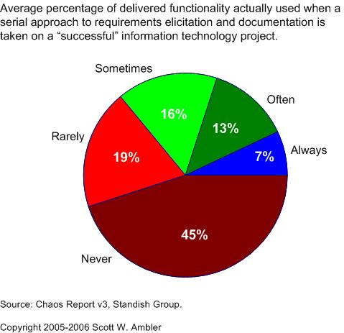
Value of Delivered and non-used Features

Slide 8
The scope of this course is to introduce participants to International Standard of Project Management practices, an Overview of the framework
The Terms, Terminologies & Discussions will be based on Project Management concepts and framework referred to
Project Management Institute, PMI (US), Publication : PMBOK® Guide Fourth edition, (Project Management Body Of Knowledge)

Slide 9
Introduction to Project Management Framework

Slide 10

What Forces Aggression to Come Up?

Slide 11

What Forces to infuse Metal in Muscles?

Slide 12
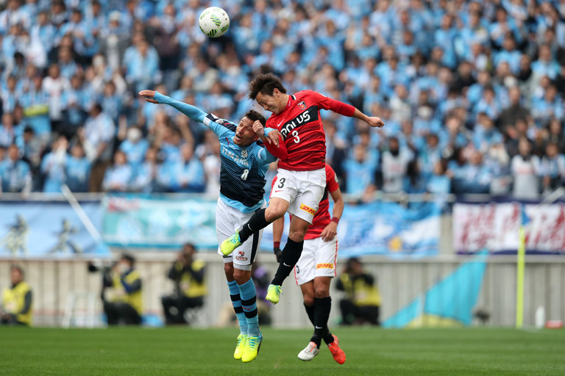
What Forces to Learn Flexibility & Trick?

Slide 13
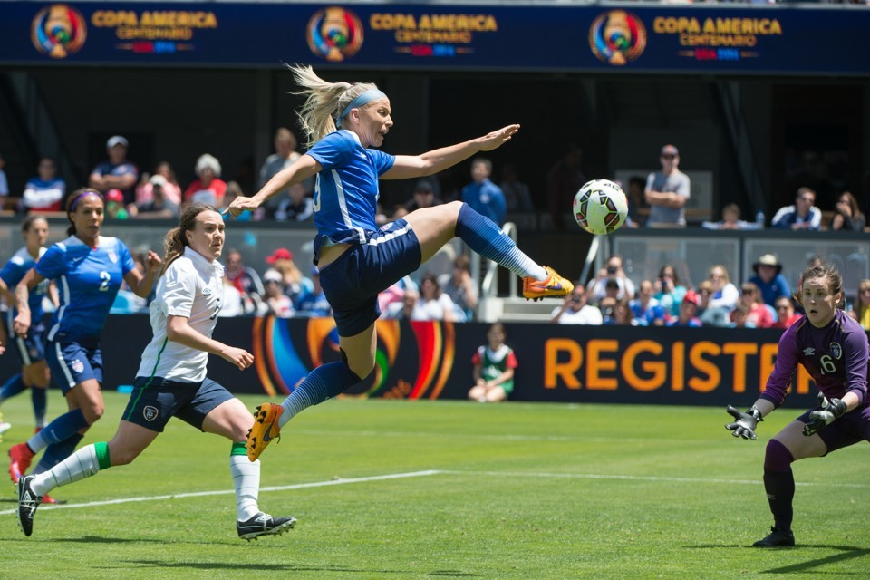
What Gives us so much Energy?

Slide 14

What brings feeling of together in Success

Slide 15
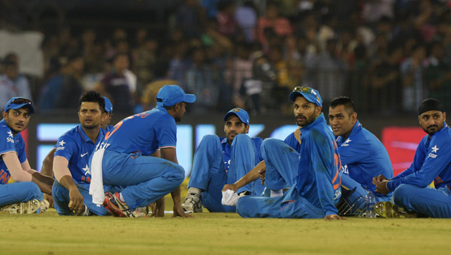
What brings feeling of together in Failure?

Slide 16
What is a Project?
‘A Project is a temporary endeavor undertaken to create a unique product or service’
Temporary : ‘every project has a definite beginning and a definite end’
Unique: ‘the product or service delivered is different from others’
Organizations resort to Projects to achieve their strategic needs, which cannot otherwise be attained through normal operational means.
Notes:
Seven wonders of the world
Pyramids
Product or service or capability to create the product/service(building, business function, org restructuring), research project)
Temporary- end- when proj objectives are met or not met or cannot be met-; need no longer exists-aborted.
Uniqueness- contactor, budget, configuration, location..etc; repititive elements could be there---similar projects or degree of similarity.
Portfolio, Program, Project
Portfolio- L&T Infra dvision—has projects in oil, power, gas, water, airport…(portfolio)-objective to maximize returns; program –within power (projects in power or in airport)
I may have a portfolio of stocks across Banking, Infra, commodities, IT….Banking stocks are from banking program (inter dependencies--)

Slide 17
Source of Project?
Need for improvement
Market Competition
Strategic/ Mission/ Vision
Government Regulation
Environmental Forces

Slide 18
Project From Idea to Deliverable
Problem / Need for Change
High Level Solution Conceptualization (SOW)
Business Case (estimation, approach)
Proposal
Agreement
Project Charter
Project Planning (detailing, estimation, scheduling)
Execution & Project Governance
Project Closure
Benefits Measurement

Slide 19
Project vs Operations
Attribute | Projects | Operations
Charter | Permanent Project Charter | Semi-permanent charter
Change | Catalyst for change | Maintains status quo
Product | Unique product or service | Standard product or service
Team | Heterogeneous teams | Homogeneous teams
Time | Start and end date | Ongoing
Requirments | Progressive elaboration | Predefined product

Slide 20






Project Constraints
Evaluate the competing demands and their impact on project outcomes.
Risk
Scope
Project and Product Quality
Schedule
Cost
Resource

Slide 21
What is Project Management?
‘Application of knowledge, skills, tools and techniques to project activities to meet the Project requirements’
People with skills, knowledge and motivation
PEOPLE
Procedures and methods defining the relationship amongst tasks
Tools and Techniques to perform Processes
PROJECT MANAGEMENT
PROCESSES
TOOLS
Notes:
Processes – Communication
Tools – Knowledge, Skills
Resource comes from the organization.

Slide 22
Project From Initiation to Closure
Initiation
Monitor & Controlling
Execution
Closure
Final Product, Service & Result
Organization Process Assets Update
Planning
Planning (Initial)

Slide 23
Project Phases
Project Phases
Projects are divided into phases where extra control is required to effectively manage the completion of the major deliverables
Collectively, the project phases put together is known as Project life cycle
Each phase is marked by one or more tangible verification work product
The conclusion of a project phase is generally marked by a review
The phase end points are referred to as phase exits, milestones, phase gates, decision gates, stage gates or kill points
Starting a phase before approval of deliverables of a previous phase is called Fast Tracking
Your Project Must have Phases

Slide 24
Understanding Project Lifecycle
Performing Organization/ Stakeholders
Phase I
Phase II
Phase III
Phase IV
Closure
Initiation
Exits
Exits
Exits
a
b
c
d
Deliverables
Notes:
What is a lifecycle? Delivery strategy
Conceived, born, childhood, teenage, adult, working adult, married adult, parent, retired, obsolete
(transition from one state to the other needs to be clearly defined--tollgates)
Phase- logical grouping of related tasks, deliverables
Hybrid models
SAP-LIFECYCLE- Proj preparn, Bus blueprint,realizn, Final preparn, Go live and support

Slide 25
Who are Stakeholders?
Stakeholders
Persons or organizations who are actively involved in the project or whose interests maybe positively or negatively affected by the performance or completion of the project
Source PMBOK Guide Version 5.0

Slide 26
Stakeholders
Stakeholders
Internal
Top Management
Program Management
PMO
Project Director
Project Sponsor
Project Manager
Operation Manager
Functional Manager
Technical & Engg Group
Team Members
Customer
Client's Top Management
Portfolio Management
Program Management
Client Site PM
End User
Project Sponsor
External
Vendors (Various Supplier)
Community (Leaders)
Government (Departments)
Auditors

Slide 27
Let's Prepare Stakeholder Register

Slide 28
Value Delivery & Project Life Cycle
Lifecycles: Waterfall- Iterative- Agile
Define
Design
Develop
Test
Deploy
Iteration-1
$
Phase1
Phase2
Phase3
Phase4
Phase5
Define
Design
Develop
Test
Deploy
$
Agile
Waterfall
Define
Design
Develop
Test
Deploy
Iteration-2
$
Define
Design
Develop
Test
Deploy
Iteration-3
$
Iterative
Define
Design
Develop
Define
Define
Define
Design
Design
Design
Develop
Develop
Develop
Test
Test
Test
Test
Deploy
Deploy
Deploy
Deploy
Iteration
Iteration1
Iteration2
Iteration3

Slide 29
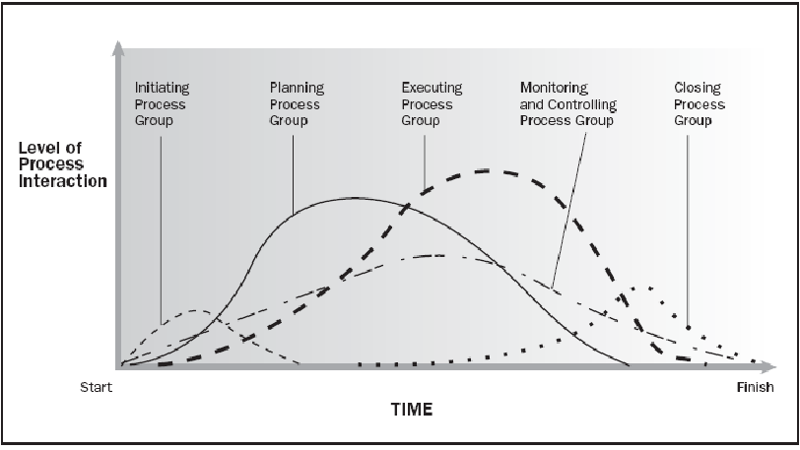
Project Lifecycle (PLC) & Level of Activities
Source PMBOK Guide Version 5.0

Slide 30
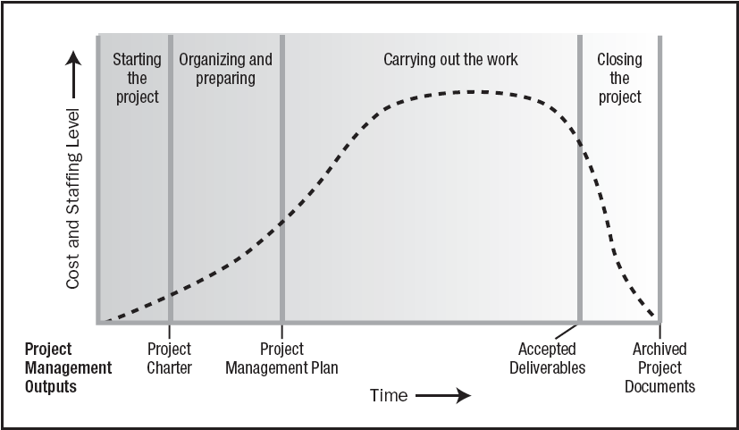
Typical Costing & Staffing across PLC
Source PMBOK Guide Version 5.0

Slide 31
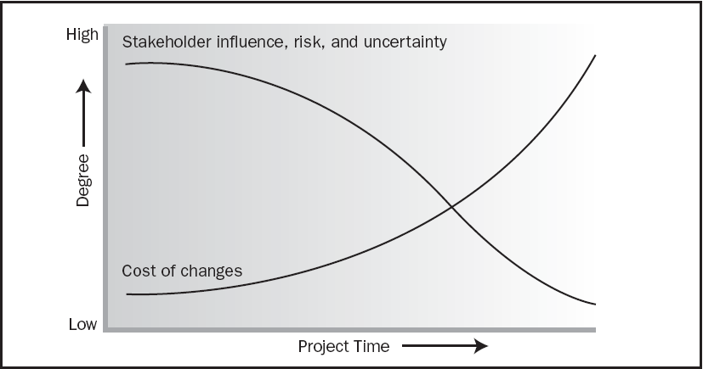
Risk, Cost of Change in PLC
Source PMBOK Guide Version 5.0

Slide 32
Project Success Rate & Organizational Types
Functional
Matrix
Weak Matrix
Balanced Matrix
Strong matrix
Projectized

Slide 33
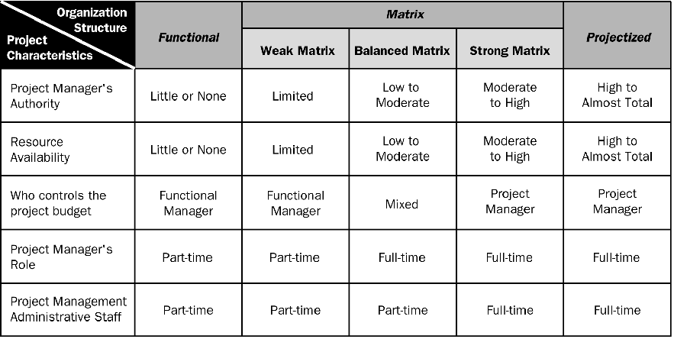
Organizational Influence
Source PMBOK Guide Version 5.0

Slide 34
Progressive Elaboration
Project scope unfolds during the project execution. Scope of the next phase depends upon the output or success of previous phase.
It is Scope Management Concept.

Slide 35
Rolling Wave Planning
Activities of any deliverable can be known when we know what need to be delivered.
Attribute of the activities can be known only when we know what are the activities and what are deliverables.
It is Time Management Concept.

Slide 36
Project Data, Information, Report

Slide 37
Project Management Plan
Project Management Plan includes
All Subsidiary Plan (Configuration, Cost, Risk etc)
All Baselines Related to Project
Project Management Methodology
Project Lifecycle and Project Phases
Process Tailored List
Tailored Process

Slide 38
Subsidiary Plan
Subsidiary plan needs to be developed for each aspect of the project. For every aspect (Scope, Time, Cost, Quality, Resources, Communication, Risk, Stakeholder) you need to know following
What are the activities which need to be done?
Who will perform these? Is any training required to perform these activities.
When these activities will be performed?
How will you measure success?
What tool you will use for this?
How will you execute the work of this aspect?
How will you control this aspect?
Most of these activities are related to Planning of the Plan and NOT of the planning of Execution

Slide 39
Management by Exception
Project Manager should have enough control required to manage the project with minimum day intervention from the Management
Project boards should have checkpoint and event based control over the project
Project manager and project board should work within their tolerance limit of scope, time, cost and quality
Tolerance limit should be defined in project management plan.

Slide 40
Organizational Process Assets
Process Assets which created by the organization while doing the project in past
Processes, Standards, Guidelines, Checklist, Templates standardized by the Quality Department or PMO
Lessons learned report of the previous projects
Consider them for project Initiation, Planning, Executing, Monitoring & Controlling and Closing. Do not reinvent the wheel in project management.
e.g. Time/Cost/Resource Estimation database, Risk database, Issue Register, Skills Database

Slide 41
Enterprise Environmental Factors
Constraints which are not in control of a Project Manager and the project manager has to consider them to make project successful.
These constraints are imposed by environment of those enterprises which are involved in the project
Consider them for project Initiation, Planning, Executing, Monitoring & Controlling and Closing
e.g. Skill Availability, Market Condition, Attitude of People, Organization Culture, Climatic Condition, Political Condition, Bosses etc.

Slide 42
What are EEFs & OPAs of My Project?

Slide 43
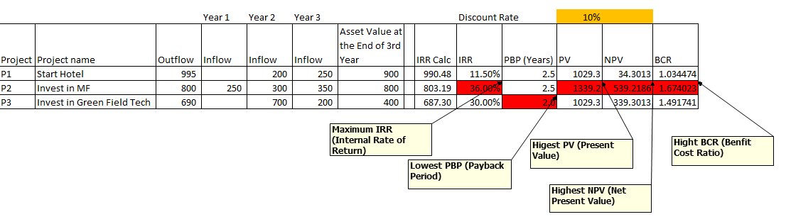
Project Selection Criteria
PBP- Payback Period is a time in which original invest is realized.
PV = FV / (1+ r)^n
PV= Present Value
FV= Future Value
r = Discount Rate
n = Number of Years
NPV = Inflow – Outflow (Take Positive Value)
IRR = A discount rate at which [Outflow – Inflow =0 ]
BCR = Benefits (Present Value) / Cost (Output)

Slide 44

Project Manager Responsibilities
Project Manager’s Role
Estimates of size, efforts & schedule
Risk identification, analysis, prioritization, monitoring & control
Resource allocation, resource backup and utilization
Scope management
Communication- reviews, steering committee meetings, stakeholder identification and expectation management
Stakeholder Expectation Management
Defect free product delivery on time within budget
Team motivation, team management, training & development, appreciation, career planning, interview
Deliver as per contract & proposal
Procure as per contract & proposal
Configuration management, data backup
Quality planning
Cost optimization
Presales & proposals
Technical guidance to team – if team members are not available do their work (after project manager has completed his work & he has spare time)

Slide 45
10 Aspects of Project
Scope
Time
Cost
Quality
Human Resource
Communication
Risk
Procurement
Stakeholder
Integration

Slide 46
Process Groups
Project Management Processes Can be grouped in 5 groups
Initiation Processes
Planning Processes
Executing Processes
Monitoring and Controlling Processes
Closing Processes

Slide 47
Project Initiation

Slide 48
Project Charter
First document created by Project Sponsor
To formally acknowledge the existence of the project within organization
Identify and authorize project manager
To document all the initial understanding between project sponsor and project manager
Should not be more than 2 page in size.
More the work has been done before writing Project Charter more realistic estimate it has.

Slide 49
Project Charter Template
Project purpose or justification
Measurable project objectives and related success criteria
High – Level Requirements/Deliverables
High – Level Project description
High – Level Risks, Assumptions, Dependencies, Constraints
Summary milestone schedule
Summary Budget
Project approval requirements
Assigned project manager, responsibility, and authority level
Name and authority of the sponsor or other person(s) authorizing the project charter
Project Start date

Slide 50
Understand Project Boundary
In the Frame / Out of the Frame Flip Charts
Notes:
Areas IN GREY—tbd….TICKING bomb …by when…tbd till end of project;sitting on the fence
Functional, Non functional- user manual, training, installation, user support,

Slide 51
Prepare Project Charter

Slide 52
Project Planning

Slide 53
Scope Aspect
Scope Management Plan
Requirement Management Plan
RTM
WBS
WBS Dictionary
Scope Baseline

Slide 54
Scope of Work
While planning consider both
Project Scope "The work that needs to be accomplished to deliver a product, service, or result with the specified features and functions."
Product Scope "The features and functions that characterize a product, service, or result."

Slide 55
The Work Breakdown Structure
The Work Breakdown Structure is a hierarchical chart used to organize the work of a project into related areas
It shows the breakdown of a project depending on the visibility and control needed
Each of these major components are then subdivided into the tasks necessary to reach successful project completion
Each of these major components are then subdivided into the work necessary to reach successful project completion.
Notes:
Decomposing till what level of granularity…till duration of the task is not more than 5 working days. Based on project duration/milestone…..if project is 15 days..then daily/agile.
Verbs, specific outputs that are measurable
More the granularity , more the visibility, more is the possibility of control; greater is the PM overhead. But for long durn, weekly may be too much; tied to tracking and reporting needs.
Breakdown to atleast 2 levels
Should be assignable, trackeable, estimatable
But for a new team member, greater; or only at TL level…they will in turn breakdown

Slide 56
WBS Types
Phase Driven
Department Driven
Milestone Driven
Component Driven
Location Driven
…….

Slide 57
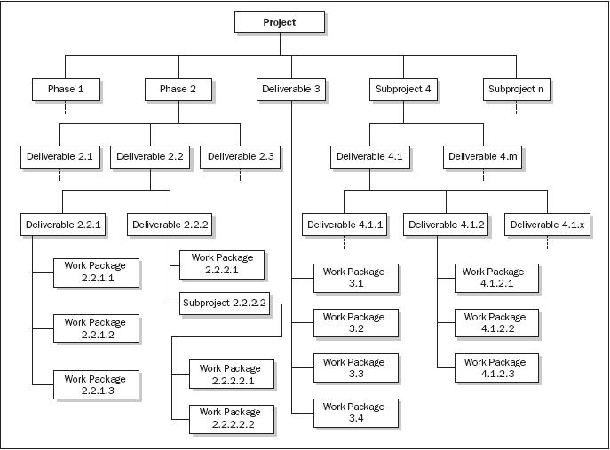
Phase oriented WBS

Slide 58
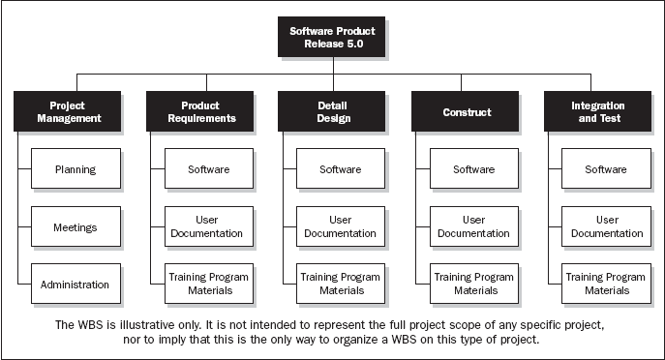
Department oriented WBS

Slide 59
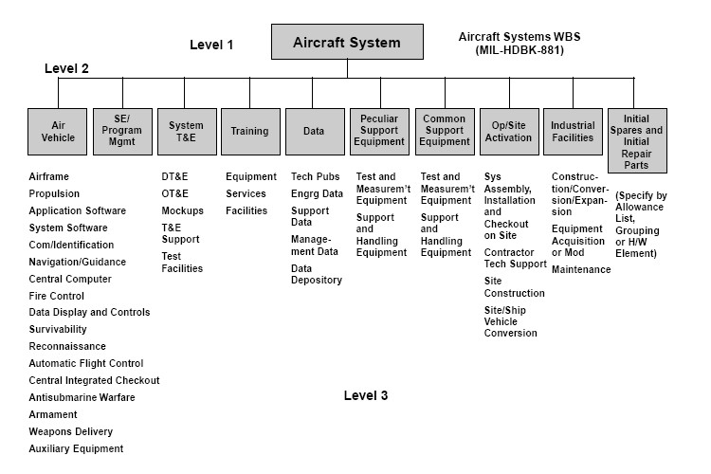
Subproject Oriented WBS

Slide 60
My Tools & Techniques
Interviews
Focus Groups
Facilitated Workshops
Group Creativity Technique
Group Decision Making Techniques
Questionnaires and Surveys
Observations
Prototypes
Benchmarking
Context diagrams
Document Analysis
Product Analysis
Product breakdown
System analysis
Requirement analysis
System engineering
Value engineering
Value analysis
Alternatives Identification
Decomposition
Inspection
Notes:
Value engineering: Functions, value, cost
Retain the function & value and reduce the cost
Value analysis: Debate the function and its cost
Discuss the value of function vs the cost

Slide 61
Requirement Traceability Matrix
What is RTM?
When to setup & update this?
How to use it?
Structure of RTM
Requirement #
SOW Ref#
Functional Requirement Ref#
Design Ref#
Test Ref#
UAT Test Ref#
Status
Requirement Owner (Stakeholder)
Due Date
Type of Requirement
Dependency

Slide 62
Let's Define Success Criteria / Setup RTM for our project

Slide 63
Time Aspect
Activities
Milestones
Activity Attributes
Sequencing
Estimation- Resources
Estimation- Duration
CPM, CCM
Schedule Baseline

Slide 64
Critical Path
ES EF
ES EF
ES EF
ES EF
ES EF
ES EF
Duration 7 Task A
Duration 6 Task C
Duration 3 Task G
LS LF
LS LF
ES EF
LS LF
Duration 2 Task H
Start
Finish
ES EF
ES EF
ES EF
LS LF
Duration 3 Task B
Duration 3 Task D
Duration 3 Task E
LS LF
LS LF
LS LF
ES EF
Duration 2 Task F
LS LF

Slide 65
Critical Path – Longest Path, Zero Float
0
0
0
ES EF
ES EF
ES EF
Duration 7 Task A
0
7
Duration 3 Task G
Duration 6 Task C
13
16
7
13
0
7
7
13
13
16
0
LS LF
LS LF
ES EF
LS LF
Duration 2 Task H
16
18
Start
Finish
7
7
7
16
18
ES EF
ES EF
ES EF
LS LF
Duration 3 Task B
0
3
Duration 3 Task D
3
6
Duration 3 Task E
6
9
7
10
10
13
13
16
LS LF
LS LF
LS LF
8
ES EF
Duration 2 Task F
3
5
11
13
LS LF

Slide 66
Discussion/Excertise-16
5 Minutes
ES EF
ES EF
ES EF
Duration 4 Task A
Duration 4 Task B
Duration 3 Task C
LS LF
LS LF
LS LF
ES EF
ES EF
Duration 10 Task G
Start
Duration 7 Task D
Finish
LS LF
ES EF
LS LF
ES EF
Duration 5 Task E
Duration 5 Task F
LS LF
LS LF

Slide 67
Network Exercise - solution
Critical Path : ADCG
ES EF
ES EF
ES EF
Duration 4 Task A
0
4
Duration 3 Task C
Duration 4 Task B
11
14
4
8
0
4
7
11
11
14
LS LF
LS LF
LS LF
ES EF
ES EF
Duration 10 Task G
14
24
Duration 7 Task D
Start
4
11
Finish
14
24
4
11
LS LF
ES EF
LS LF
ES EF
Duration 5 Task E
0
5
Duration 5 Task F
5
10
4
9
9
14
LS LF
LS LF
Notes:
Free float: An activity can be delayed without impacting the start of next activity
Total float: As many alternative path that many total float. Total float is available on non critical path. Activities can be delayed without delaying project
Free float on critical path activities is Zero

Slide 68
Facts/Tips for Critical Path
Total Float is the amount of time the task can delayed without delaying the project finish date.
Free float is the amount of time a task can slip without delaying the early start of any task that immediately follows it
It is possible that a zero float activity may not be on critical path
Longest path & shortest time possible to complete the project
A project can multiple critical paths
Difference between late and early is float
Positive float (the activity can wait to start even after previous activity finishes)
Negative float (the activity must start before previous finishes)
Zero float (the activity must immediately start after the finish of previous one)
Crashing activities to short the overall duration of project
Fast-tracking activities to short the overall duration of project
Be cautious that non-critical activity is not being delayed than the allowed free float
Take care of sub-critical path or non-critical path
Manage critical path resources very closely
Do not overload critical path activity resources
Avoid multitasking for resources working on critical path activities

Slide 69
My Tools & Techniques
Precedence Diagramming Method
Dependency Determination
Alternatives Analysis
Group Decision Making Techniques
Reserve Analysis
Schedule Network Analysis
Critical Path Method
Critical Chain Method
Resource Optimization techniques
Modeling Techniques
Leads and Lags
Schedule Compression
Scheduling Tool

Slide 70
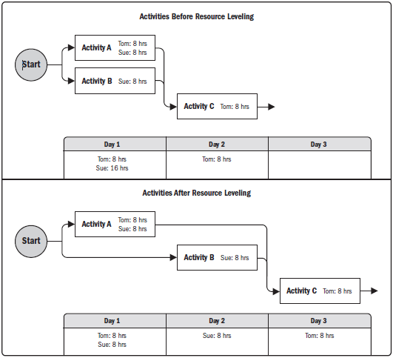
Resource Optimization Techniques
Resource Levelling
Ensure resource are not allocated more than their availability for the given project. Can lead to change in critical path.
Resource Smoothing
Adjust activities in such a way that resources requirement do not exceed than defined limit. No change in critical path. Activities can be delayed within their float (free/total).

Slide 71
Estimation Techniques
Analogous Estimation
PERT Estimation
Parametric Estimation
Bottom-up Estimation
Expert Judgement
Wideband Delphi
Published Estimated Data

Slide 72
Critical Path Identification/ Optimization

Slide 73
Cost Aspect
Estimating Activity Cost
Documenting Basis of Estimation
Funding Requirements
Determine Cost of Quality
Cost Baseline

Slide 74
My Tools & Techniques
Cost of Quality
Fund Limit Reconciliation
Cost Aggregation
Earned Value Management
Vendor Bid Analysis
Forecasting Methods
Progress Review Methods

Slide 75
Project Cost Estimation Ranges
Cost estimation may include only Direct Cost or in combination of with Indirect Costs
Class Name | % | Range
Definitive | - 5 -> +5% | 10%
Capital Cost | -15 -> +10% | 25%
Appropriation | -25 -> +15% | 40%
Budget Estimates | -10 -> +25% | 35%
Feasibility | -35 -> +25% | 60%
Order of Magnitude (Ballpark Estimate) | -50 -> +50% | 100%

Slide 76
Type of Costs
Transaction cost: Example- Buying a used car. Search, Bargain, Policy
Sunk/Retrospective Cost: a cost that has already been incurred and cannot be recovered. Sinking cost in installation of some software/systems. Selling a newly purchased car.
Opportunity Cost: choice of a best alternative lost while making a decision. The opportunity cost of leaving their money in the Chinese stock market or Chinese real estate market is too high relative to yields available in the USA real estate market. The cash expenditure of $100 represents a lost opportunity to purchase something else with the $100.
Material Cost: Material are those things which will be consumed in the project and cannot be taken out of the project after product is handover to customer.
Labour Cost: Cost of human resources, for which project has to pay for every hours of timesheet.
Service Cost: Cost of equipment, testing, training, third party audit.
License Cost, Network equipment Cost are material cost

Slide 77
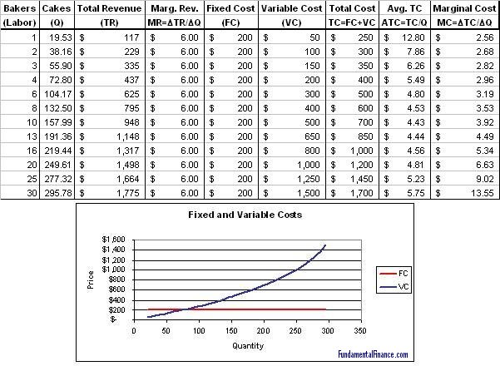
Classification: Type of Cost
Variable Cost: Pay on usage. Depends upon output.
Fixed Cost: Fixed for per period irrespective of usage.

Slide 78
Classification: Type of Cost
Direct Cost : Cost of resources, which are used for a specific activity.
Indirect Cost or Overhead Cost: Cost of resources, which are used for multiple activities. Admin Salaries, Rent, Utilities,
Admin Overhead
Manufacturing Overhead

Slide 79

Total Cost of Ownership
Cost of Development
Cost of Deployment
Cost of Maintenance
Cost of Support
Cost of Phasing out

Slide 80
Let's Discuss Cost Component of our Project

Slide 81
Connecting dots ….. Estimation, Range, Confidence, Assumptions

Slide 82
Quality Aspect
Plan Process Audit
Plan Inspection and Testing
Plan Process Improvement
Prepare review, inspection, test checklist
Identify metrics to measure project and product quality
System for data collection, analysis and logging variance

Slide 83
7 Basic Quality Tools
Check Sheet
Histogram
Pareto Chart
Scattered Diagram
Flowchart
Fishbone Diagram
Control Charts

Slide 84
"As much as 95% of quality related problems in the factory can be solved with seven fundamental quantitative tools." - Kaoru Ishikawa

Slide 85

Check Sheet

Slide 86
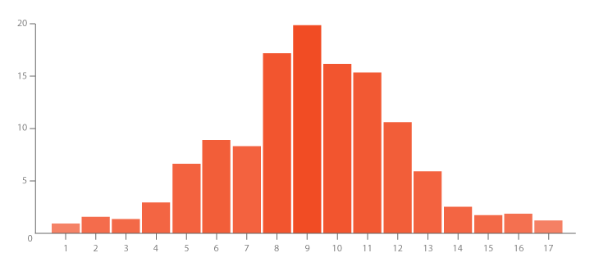
Histogram
From a set of data compute
Sum
Mean (x)
Max
Min

Slide 87
Histogram
Data Set from last Thursday(pizza slices of Pizza Hut)
2 2 1 2 2 4 1 3 1 2 1 2 2 4 3 4 1 4 3 2 2 3 2 1 2 2 1 2 2 1 4 2 2 1 2 1 2 2 1 2 1 2 1 2 1 2 1 2 1 2 2 2 1 2 1 2 1 1 2 2 2 3 1 4 2 2 3 2 2 2 1 2 3 2 2 4 2 2 4 4 1 2 2 2 3 2 2 1 2 2 4 2 1 2 4 2 1 7 2 1 2 2 3 1 2 1 1 2 1 2 2 2 1 2 2 1 2 1 2 2 2 4 0 4
Mean = 2.032258
Max = 7
Min = 0

Slide 88
Histogram
Staff hours
300
275
Senior Designers
250
225
200
175
Resource Usage
150
125
100
75
50
25
0
9
16
23
30
6
13
20
27
6
13
20
27
3
10
17
24
1
8
15
22
Jan
Feb
Mar
Apr
May
Weekly Resource Usage Staff Hours

Slide 89
Pareto Chart
Slices | Frequency | %
0 | 1 | 0.8%
1 | 33 | 27.5%
2 | 65 | 54.2%
3 | 8 | 6.7%
4 | 12 | 10.0%
5 | 0 | 0.0%
6 | 0 | 0.0%
7 | 1 | 0.8%
80/20 Rule

Slide 90
Pareto Chart

Slide 91
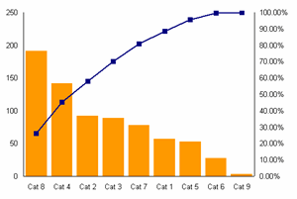
Pareto Chart

Slide 92
Scattered Diagram
Minutes Defective
Cooking Pies
10 1
45 8
30 5
75 20
60 14
20 4
25 6
In this simple example, you can find the existing relationship without much difficulty but…
Defective Pizzas
Time Cooking (minutes)

Slide 93
Flowchart
A graphical picture of a PROCESS
Process
Decision
The process flow

Slide 94
Fishbone Diagram
Problem: High Inventory Shrinkage at local Drug Store
Employee
Attitude
Training
New Trainee
Benefits
Practices
Shrinkage
Anti-theft tags poorly designed
Expensive merchandise out in the open
No security/ surveillance
Shoplifters

Slide 95
Control Chart
Pizza Hut Management wants to get in on the control chart action
Average Diameter = 16 inches
Upper Limit = 17 inches
Lower Limit = 15 inches

Slide 96
Control Chart
What do you interpret from this chart?
Upper Limit
17 inches
Lower Limit
15 Inches
16 inches=
X
Small Pie

Slide 97
Some Other Analytical Tools
Run Charts
DOE
Mind Map
PESTLE
QFD
Value Stream Mapping
Value Chain Analysis
Variance Analysis
What if Scenario Analysis
Decision Tree

Slide 98
Run Charts
Pizza Hut counter.
What do you interpret from this chart?
Slices/hour
5
10 15 20 25 30 35 40 45 50 55 60 65 70 75 80 85 90 95 100
8 9 10 11 12 1 2 3 4
8 9 10 11 12 1 2 3 4
8 9 10 11 12 1 2 3 4
Time
PM- AM
PM- AM
PM- AM
Thursday
Week 1
Thursday
Week 2
Thursday
Week 3

Slide 99

DOE
Design of Experiments is an analytical technique, which aims using testing (experiments) to test different values ​​of quality system or product.
Reduce time and cost, design and testing of a product or system
Improving the quality of a product or system
Reducing the cost of pilot series

Slide 100
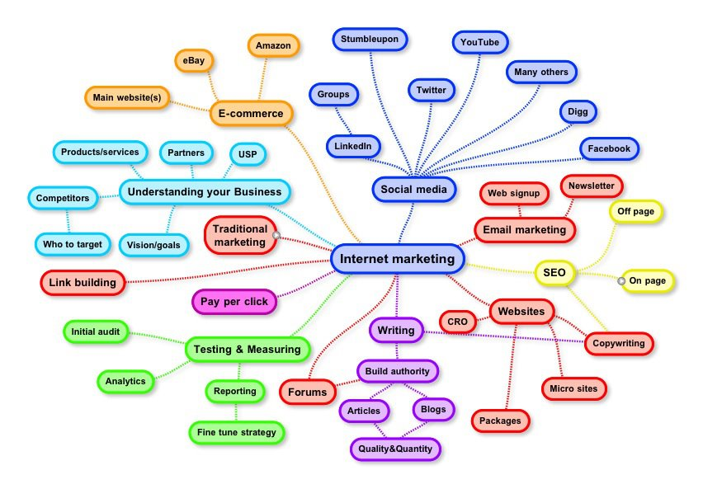
Mind Map

Slide 101

PESTLE
PESTLE Analysis is an analytical technique used for the strategic analysis of organizational surroundings.
Political
Economical
Social
Technological
Legal
Ecological

Slide 102
QFD (Quality Function Deployment)
QFD is used for quality planning in the development of customer requirements into product requirements. It therefore converts customer requirements to product characteristics. This method
Reducing the number of product changes
Reducing the cost of the product development
Shorten the product development time
Transfer the customer requirements into the final product

Slide 103
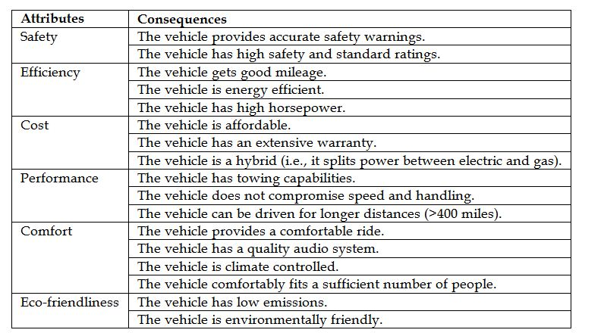
QFD

Slide 104
Value Stream Mapping (VSM)
It uses a graphical display of the flow value (flow value visualization), which can be financial, material, information or other and it helps deeper understanding of the entire flow of the production processes that pass through the entire organization and its relation to the organizational management system, planning and customer requirements.

Slide 105
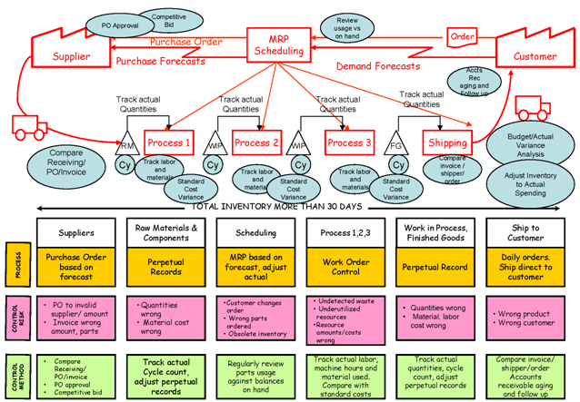
Value Stream Mapping (VSM)

Slide 106

Value Chain Analysis
Value Chain Analysis is a useful tool for working out how you can create the greatest possible value for your customers.
Activity Analysis: First, you identify the activities you undertake to deliver your product or service.
Value Analysis: Second, for each activity, you think through what you would do to add the greatest value for your customer.
Evaluation and Planning: Thirdly, you evaluate whether it is worth making changes, and then plan for action.

Slide 107

Variance Analysis
Compare actual vs planned

Slide 108
What if Scenario Analysis
Assess the feasibility of project schedule under adverse conditions. Prepare a contingency plan to overcome the problems. Or prepare mitigation plan to reduce the impact of unexpected situations.

Slide 109
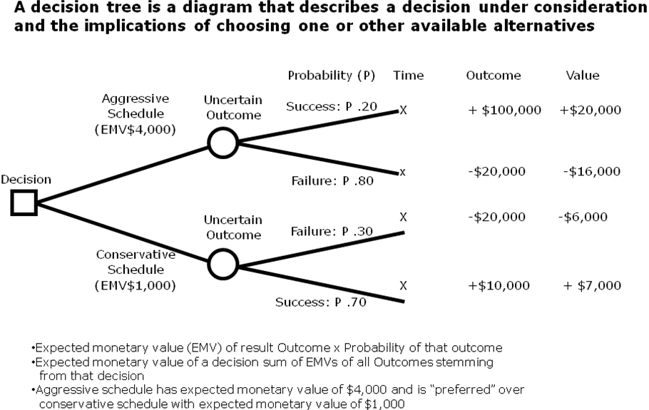
Decision Tree

Slide 110
Human Resource Aspect
Staffing Plan
Calendar
Role & Responsibilities
Reporting Relationship
Training Plan
Appraisal and Feedback System
Team Motivation

Slide 111
My Tools & Techniques
Observation & Conversation
Project Performance Appraisals
Conflict Management
Interpersonal Skills

Slide 112
Types of Power
Formal – positional, granted by organizational/upper mgmt
Expert – power earned through a recognized level of knowledge or skill in a specific area
Reward – the power to give a positive consequences, like promotions, salary rise etc.
Penalty – the power to provide negative consequences, like suspension, termination, reprimands
Referent – power gained when team members admire, and willingly follow an individual as a role model

Slide 113
Responsibility Assignment Matrix - RAM
PERSON
Shiv Ram Jim Karl Rita Mohan …
PHASE
Requirements
S R A P P
Functional
S A P P
Design
S R A l P
Development
R S A P P
Testing
S P l A P
P = Participant A = Accountable R = Review required
I = input required S = Sign-off required

Slide 114
RAM for My Project

Slide 115
Team Development / Tuckman Model
Five Stages of Team development
Forming – Members of the group get to know each other and try to set up some ground rules about behavior
Storming – Conflicts arise as various members of the group try to exert leadership and the methods of operation are being established
Norming – Conflicts are largely settled and a feeling of group identity emerges
Performing – Emphasis now is the task at hand
Adjourning – The group disbands
Sequence is followed for each individual/group

Slide 116
How to create cohesiveness and sense of team-play in my Team?

Slide 117
Communication & Stakeholder Aspect
What report format, who, when, how, by whom, frequency
Who will engage, when, how, frequency
Ensure communication and engagement

Slide 118
My Tools & Techniques
Communication Techniques
Communication Models
Communication Methods
Information Management Systems
Performance Reporting

Slide 119
Risk Aspect
How to perform risk management activities
Identify Risk
Analyse & Assess Risk
Plan Risk Responses

Slide 120
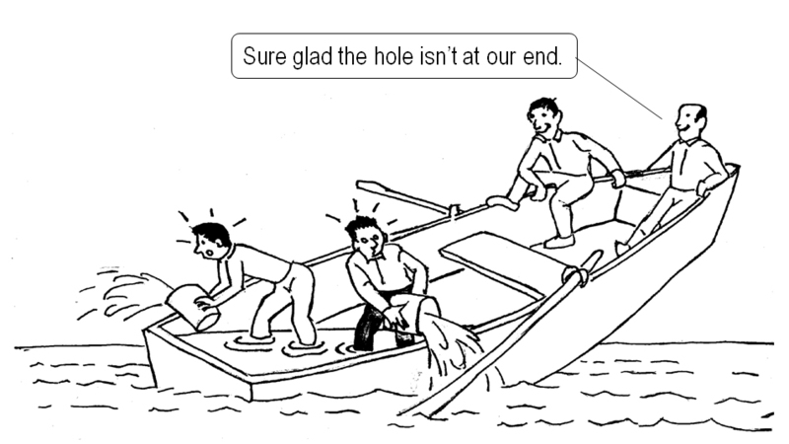

Slide 121

Who like surprises?

Slide 122
Every Project has risks associated with it!
Commercial viability.
Technical feasibility.
Competitors move ‘faster’.
Customers’ preferences may change.
‘VC’ resources may ‘dry up’.
Project Sponsor changes or may not give continued support.
Attrition.
Project scope, time or cost related issues.
Government regulations.
Notes:
Technical risks- lifecycle, product/technology obsolescence
Management risks- Planning, estimation, budgeting, resources
Commercial- exchange rate , payment default
Legal- obligns failure

Slide 123
My Tools & Techniques
Documentation Review
Checklist Analysis
Risk Data Quality Analysis
Strategies for Negative Risk or Threats
Strategies for Positive Risk or Opportunities
Contingency Reserve Determination
Assumption Analysis
SWOT Analysis
Expert Judgement

Slide 124
Risk Event / Impact matrix
Contingency Reserve
Management ‘kept’ Reserve
Unknown
Impact
Planning
N.A.
Known
Known
Unknown
Event
Notes:
Unknown unknown- Recession, customer demand/appetite changes, technology changes, new product-game changer has hit the market, farmer agitn –singur—recovery/continuity at Gujarat..
Known-known--- cust may not signoff; team member may leave, resource may not be available..
Known- unknown-----I know customer changes his mind, but don’t know impact;
Unknown-unknown--- don’t know if cycle will change; don’t know if recession might happen; don’t know if suddenly regulations change; don’t know whether customer may delay payment; don’t know if competition announces new changes.

Slide 125
Risk Management Process
Risk Assessment
Risk Control
Risk Database
Risk identification
Risk analysis
Risk prioritization
Risk response planning
Risk resolution
Risk monitoring
Project Lifecycle
Notes:
Self Explanatory slide !

Slide 126
Risk Estimation

Slide 127
Risk Prioritization
Rank each Risk based on the exposure

Slide 128
Good Risk Management Practices
Acknowledge that risks are inevitable.
Communicate risks openly.
Reward people who prevent crisis, not just those who create crises and then manage them.
Use organization’s risk database for cross project learning.
Take the Expert help whenever needed.
Remember all risks are important .
Notes:
Self Explanatory slide !

Slide 129
Bad excuses in Risk Management
We have no risk.
We deal with problems as they arise.
How can you predict what will happen 6 months from now?
Our job is to develop software, not to fill out bureaucratic forms.
That external interface is not in our risk management program because the interface is not our responsibility.
We deal with problems as they arise.
That method is proven and therefore not a risk. The speaker at the conference said so.
My tech people will rebel if we identify as a risk a lack of skills needed to do development.
We have to bid the lowest cost to win; we'll worry about doing the job when we get it.
(source-The Little book of bad excuses- SPMN)

Slide 130
Risk Response Strategies
Risk Responses: Threats & Opportunities
Threats or Positive Risk or
Negative Risk Opportunities
Avoid Exploit
Transfer Share
Mitigate Enhance
Acceptance Acceptance

Slide 131
Let's Prepare a Risk Register

Slide 132
Procurement Aspect
What is needed, when, where, how to ensure quality
Process of changing procurement contract during execution
Procurement Contract types
Tender documents
Make or Buy Decision
How to select vendors
Legal part of agreements

Slide 133
My Tools & Techniques
Market Research
Make Buy Decision
Contract Types Determination
Expert Judgement

Slide 134
Contract type & Risk
100%
Buyer
Risk
Seller
0%
CPPC
CPFF
T&M
CPAF
CPIF
FPEPA
FPIF
FP

Slide 135
What service/product we procure? What kind of contract is that? Who makes decision of completeness of work?

Slide 136
Project Execution

Slide 137

Perception Management
People give their own meaning to the data, event, behavior to the world around them is perception creation.
Perception is about organizing the data and creating an image in mind.
Only through validation you can find that perception was correct or incorrect.

Slide 138

What do you see?

Slide 139
Perception Management Steps
Think: How people are perceiving you
Know: How you are actually being perceived
Decide: How you want to be perceived
Story: Create a full end-to-end consistent story, which you want tell to achieve your goal
Meet: Meet to the people and tell your story
Feedback: Ask them questions which helps you in knowing whether your goal is achieved
Confirm: Paraphrase the feedback to confirm whether you understood properly
Thanks: Say thanks to people who have given time to listen your story.
By: Hari Thapliyal

Slide 140
Overall Aspect
Authorize work
Track Progress
Intervene if there is deviation happening or needed from the plan
Coordinate with stakeholders
Ensure resources are available on day to day basis

Slide 141
My Tools & Techniques
Work Authorization System
Project Management Information System
Meetings (Standup, Work Review, Trouble Shooting)

Slide 142
Quality Aspect
Ensure process are being followed
Review process being audited
Recommend change in the process if needed
Observe the best practices from project for institutionalization

Slide 143
Human Resource Aspect
Hire people or move people from other department into the project
Interview people for skills, attitude, value system
Set expectation as per the team ground rule
Motivate people to delivery high quality work on time and budget
Give feedback to the team members
Conduct training and team building activities
Check effectiveness of training and team building activities

Slide 144
My Tools & Techniques
Interpersonal Skills
Training
Team-building activities
Ground Rules
Co-location
Recognition and Rewards
Personnel Assessment Tools
Pre-assignment
Negotiation
Acquisition
Virtual Teams
Multi-criteria decision analysis

Slide 145
Stages of Team Development
Forming
Storming
Norming
Performing
Adjourning
Notes:
Three chits- blame the predecessor; re-organize the team; make 3 more chits

Slide 146
Conflict Management
Conflicts - good or bad ???
Traditional view – Conflicts are bad, created by people and to be avoided
Current view – Conflicts are good and need to be confronted in order to bring out real issues and resolve them
Hot Topics

Slide 147
Conflict Management
Sources of conflict
Schedules
Project Priorities
Technical Issues
Personality Conflict
Cost
Scarce resources
Personal work styles
Administrative Procedures

Slide 148
Conflict Management
Characteristics of conflict
Conflict is natural and forces a search for alternatives
Conflict is team issue
Openness resolves conflict
Conflict resolution should focus on issues, not personalities
Conflict resolution should focus on the present not on the past
Attitude of learning from the incident helps parties in conflict life cycle

Slide 149
Conflict Resolution
Withdrawal – avoiding, giving up, stop gap, passive reaction, buying time, appropriate for “cooling off” time, no solution. Lose-lose outcome
Smoothing – grudging agreement, avoids conflict, appeasing, friendly atmosphere. No lasting solution, lose outcome
Compromising – bargaining, acceptable agreement, some satisfaction to each party, not ideal solution, trade off, a form of definitive solution. Lose outcome.
Confronting/Problem Solving – approached as an issue to be solved by examining alternatives. Give and take attitude, open dialog – direct approach, pinpoints problem, develops alternatives, objectively resolves issues, time consuming, ultimate solution, Win-Win outcome
Collaborating – leading to consensus and commitment by incorporating multiple viewpoints and insights from differing perspectives.
Forcing – Uses power, used as a last resort, ill feeling may result, Win-lose outcome. Win-Lose outcome
Notes:
Withdraw: Many times collation parties gives warning and then withdraw the support. When one party feel that discussion will not bring any result and another party is strong
Smoothing: When both parties are trying to cover the actual issue to avoid the argument.
Compromising: When both parties leave something in order to achieve some peaceful solution

Slide 150
Conflict Resolution
HIGH
SMOOTHING
(ACCOMMODATING)
PROBLEM-SOLVING
(COLLABORATING)
RELATIONSHIP
ORIENTATION
COMPROMISE
WITHDRAWAL
(AVOIDING)
FORCING
(COMPETING)
LOW
LOW OBJECTIVE ORIENTATION HIGH

Slide 151
Motivational Theories
Frederick Herzberg's Hygiene & Motivation Factors
Abraham Maslow’s Hierarchy of Needs
Expectancy Theorem of Motivation by Victor Vroom
Job characteristics model of Oldham-Hackman
Theory X & Y of McGregor

Slide 152
Communication & Stakeholders Aspects
Send routinely planned reports
Address the need of ad-hoc reports
Engage stakeholders on daily basis and optimize the power and interest balance

Slide 153
My Tools & Techniques
Communication Techniques
Communication Models
Communication Methods
Information Management Systems
Performance Reporting
Interpersonal Skills
Management Skills

Slide 154
Procurement Aspect
Ask for proposals
Evaluate proposal
Negotiate with potential vendors
Sign agreement and award contracts

Slide 155
My Tools & Techniques
Procurement Audits
Procurement Negotiations
Record Management System

Slide 156
Key Takeaways for Project Execution

Slide 157
Project Monitoring & Controlling

Slide 158
Understand the Big Picture of Measurement of Tracking
If you cannot measure you cannot manage
Vision or Destination Statement of Organization/Department
Strategic Objective Organization/Department
BSC 4 Perspective (Balanced Score Card)
Financial Performance (increase revenue, increase profit, lower cost)
Internal Business Process: Efficiency (process efficiency, lower cycle time, reduce waste)
Customer: Satisfaction (lower wait time, improve customer retention)
Organizational Capacity: Knowledge and Innovation (Improve Skills, Improve Tools, Improve Technology)
Create Strategy Map
Key Performance Indicator (KPI) of BSC
Performance Measure & Target Strategic Initiative

Slide 159
Overall Aspect
Collect information required from the sources
Prepare reports
Determine cause of variance, if any
Ensure change request are identified and classified
Take decision on change request

Slide 160
Types of Reviews/reports
Status Reports
Progress Report
Forecast Reports
Weekly reviews
Status/Progress reviews
Management reviews
Milestone/phase end reviews
Customer reviews
Vendor reviews

Slide 161
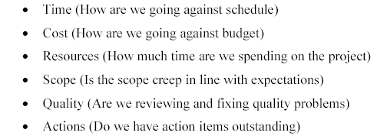
Project Dashboard (RAG)

Slide 162
Issue Management
Log issues and Issue source.
Determine action for resolution.
Establish responsibilities and timeline for action.
Track issue for resolution.
Escalate issue as per escalation procedure.

Slide 163
Scope Aspect
Ensure there is no gold-plating
Ensure work on track
Ensure customer/end users are engagement on regular basis to validate the product of the project
Take customer feedback to improve product
Approval from customer of the feature/component/work done

Slide 164
Time, Cost, Quality, Risk, Procurement
Test the product/component/output
Analyse project progress & product test data and determine variance, if any
Prepare CAPA for out of limit variances
Identify new risk, if any
Evaluate effectiveness of risk management strategy
Evaluate progress of procurement
Raise change request to vendor for fixing issues, if any

Slide 165
Earned Value Management
BAC= Variance at completion
PV = Planned Value
AC = Actual Cost
EV = Earned Value
ETC = Estimate to Complete
EAC = Estimate at Completion
SPI = Schedule Performance Index
CPI = Cost Performance Index

Slide 166
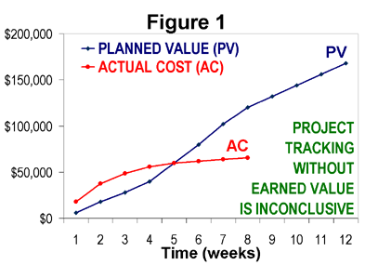
How project is progressing?

Slide 167
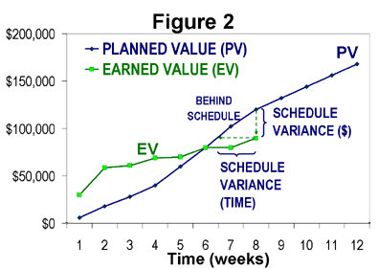
How project is progressing?

Slide 168
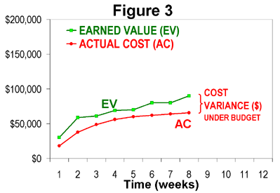
How project is progressing?

Slide 169
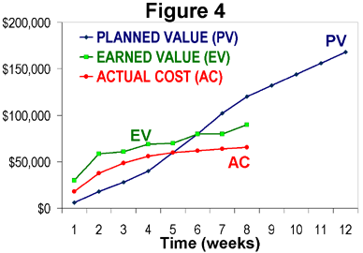
How project is progressing?

Slide 170
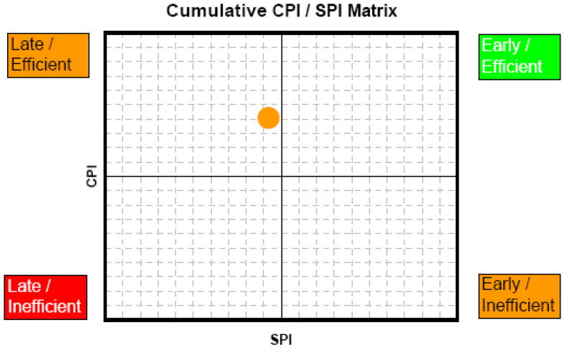
CPI & SPI Summary

Slide 171
Earned Value Rules
0% - 100%
50% - 50%
20% - 80%
25% - 75%

Slide 172
Communication, Stakeholders
Re-evaluate communication & engagement need of stakeholders
Pay attentions to the issues raised by them
Update report formats, communication plan, engagement plan, if required

Slide 173
Let's Identify Metrics Required to Manage

Slide 174
Project Closure

Slide 175
Overall, Procurement
All the procurement contracts are closed
Settle any claim issue with vendors or transfer case to account and legal department
Prepare follow-up action plan
Handover all accepted deliverables to customer
Lessons learned workshop
Share lessons learned with organization
Archive all the project repository
Inform team members and disband team

Slide 176
Project Manager in Nutshell
Project Manager’s Role
Should
Be a resourceful person who can get things done and keep all relevant stakeholders informed.
Ensure work is estimates in terms of size, efforts & schedule
Ensure risk identification, analysis, prioritization, monitoring & control is done periodically
Ensure right resource allocated for the work, resource backup and utilization
Ensure team is motivated, career planning, training and development activities are being done
Ensure scope and requirements are management
Ensure stakeholders are sufficiently engaged, their expectations are managed they are being communicated proactively
Ensure project objectives are met in terms of time, cost, scope and defect free product.
Ensure all contractual obligations are fulfilled
Ensure procurements are as per contract & proposal
Ensure Configuration management, data backup
Ensure lessons learned are documented and implemented
Ensure cost is optimized
Participate in presales & proposals

Slide 177
Agile Project Management

Slide 178
Level of Planning
Project Level Planning
Release Level Planning
Iteration Level Planning

Slide 179
Kanban Board

Slide 180
Standup Meetings

Slide 181

Hari P Thapliyal,
PMP, PMI-ACP, MCITP, Princ2 Practitioner, CSM, MBA, MCA, CIC, PGDFM
PMO Architect & Project Management Evangelist
Profile: http://in.linkedin.com/in/harithapliyal
For content related queries please contact me via
hari.Prasad@vedavit-ps.com
This document is proprietary and confidential. It remains the property of Vedavit Project Solutions at all times. No part of this document may be used, reproduced, or transmitted in any form or by any means electronic, including photocopying and recording, for any purpose without express consent of Vedavit Project Solutions.

Slide 182
Action Plan

Slide 183
Key Takeaway

Slide 184






hari.prasad@vedavit-ps.com
+91 9535999336
http://rarementors.com
https://in.linkedin.com/in/harithapliyal
@harithapliyal
http://pmlogy.com/pml/lifeisprojectplus

